Slide 1
Reading Music
A Beginner’s Guide
Notes:
get out method book, write name in it
page 2,3
page 46,47

Slide 2
Music is a language
We use music notation (letters and symbols) to write music in a way that we can read it
Learning its symbols will allow us to read it
We will learn this new language together!
Notes:
Just like learning to read letters and then words allow you to read books

Slide 3
THE STAFF
The staff is where we write music

Slide 4
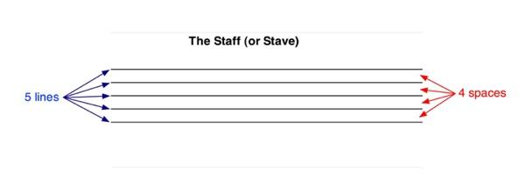
THE STAFF

Slide 5
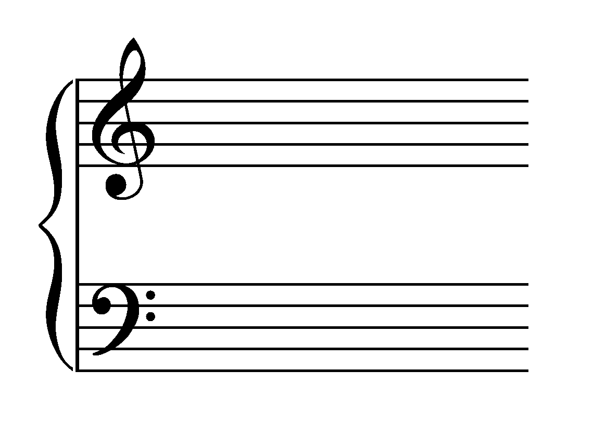
THE STAFF
The lines and spaces where we write music are split into high notes and low notes
High Notes: Treble Clef
Low Notes: Bass Clef
Notes:
Who plays with a treble clef and who plays on a bass clef?

Slide 6
THE STAFF
There is another clef that we will use in class. This is a special clef just for percussionists. Instead of showing pitches (notes high or low) it shows what percussion instrument is played (snare drum, bass drum, etc.)

Slide 7
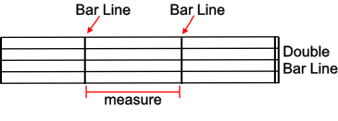
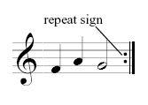
SOME BASICS
Bar Line
A line that separates the staff into measures
Double Bar Line
Two lines that indicate the end of a piece
Repeat Sign
Tells the player to return to the beginning and play again
4. Ledger Lines
Lines that extend the staff up and down
Notes:
Page 3 of your book (page 5 repeat sign)

Slide 8
Note Naming
Do You Know Your ABC’s??

Slide 9
NOTE NAMING
Musical notes are named after the letters A to G. They repeat over and over again to get notes in different octaves (example high C and low C)
Going Up (Ascending):
A - B - C - D - E - F - G - A - B - C - D - E - F - G
Going Down (Descending):
G - F - E - D - C - B - A - G - F - E - D - C - B - A - G

Slide 10
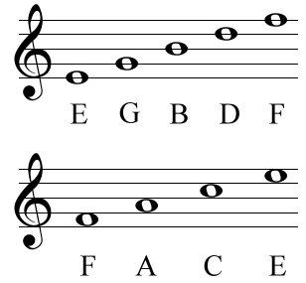
NOTE NAMING - Treble Clef
5 Lines:
Every Good Boy Deserves Fudge
4 Spaces:
The space on your FACE
Notes:
Remember this is from the bottom up

Slide 11
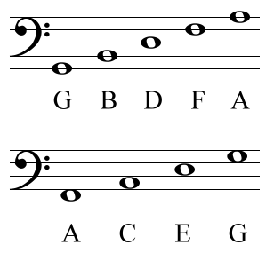
NOTE NAMING - Bass Clef
5 Lines:
Good Boys Deserve Fudge Always
4 Spaces:
All Cows Eat Grass

Slide 12
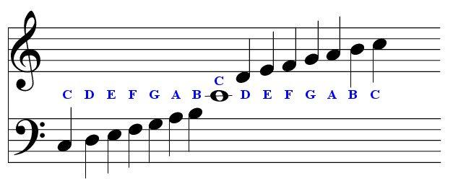
NOTE NAMING
What about the notes in the middle??
Notes:
Called middle C - Can be in both the bass clef and the treble clef. Uses the ledge lines we talked about earlier

Slide 13
NOTE NAMING - Percussion
These are your “notes” percussion! The shape and position on the staff will tell you what instrument to play that rhythm with. For now we are playing “Acoustic Snare”
Notes:
We haven’t forgotten about you!

Slide 14
Note Values
How Long Do You Hold Them?

Slide 15
NOTE VALUES
Notes can be played for short and long amounts of time.
In class we’ve done a variety of note values
(example: Ta Ti Ti Ti Ti Ta)

Slide 16
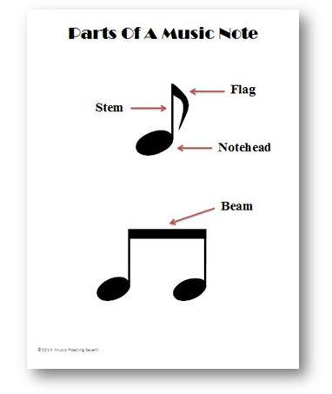
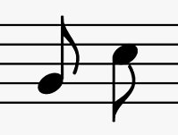
NOTE VALUES
It doesn’t matter if the notes or upstem or downstem, the naming of the note and its value remain the same
Notes:
Some of your notes may be written upside down. Everything is exactly the same, only the stem is pointing down
The note head and the flag or beam will tell you how long to hold the note

Slide 17
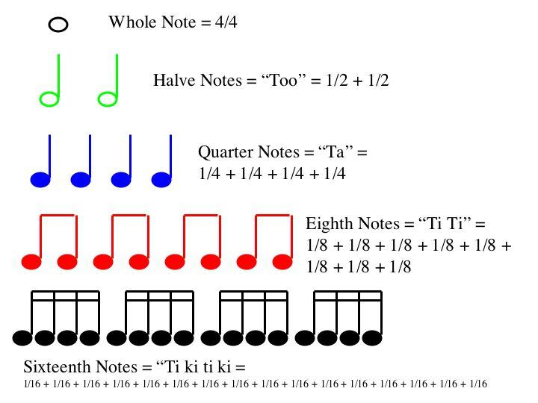
NOTE VALUES

Slide 18
NOTE VALUES
Beat vs. Rhythm
Beat - The basic unit of time in music; the “pulse”
Rhythm - The pattern of long and short notes
Notes:
When I count 1, 2, 3, inhale, I am counting the beat (or pace) of our music or exercise.
(if time, split class in 2 and play the beat verses rhythm game)

Slide 19
NOTE VALUES
What is the opposite of sound?
In music, that’s called a rest

Slide 20
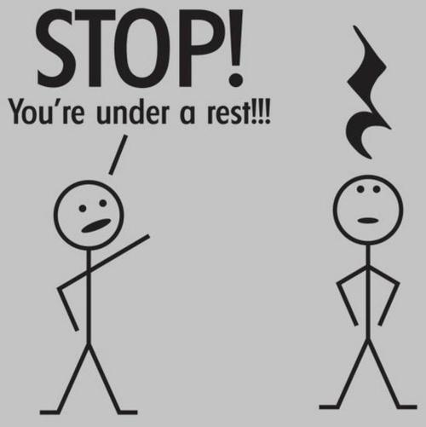
NOTE VALUES
Just like our notes, our rest have certain values as well

Slide 21
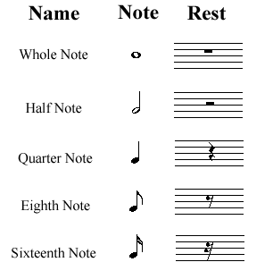
NOTE VALUES

Slide 22
THE EXTRAS
Other Things You Might See In Your Music

Slide 23
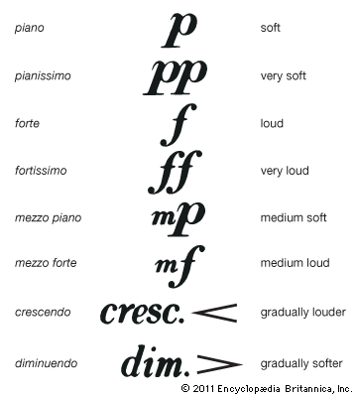
Dynamics
The louds and softs of music
(They make the music more interesting to both
the performer and the listener)

Slide 24
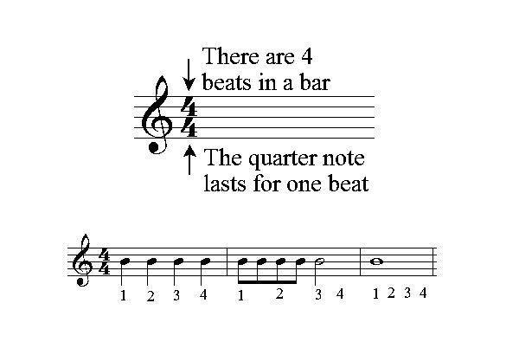
TIME SIGNATURE
An indicator of the meter of the music. Shows the amount of type of notes in each measure (it looks like a fraction)
Notes:
How many beats per measure and what kind of note gets one beat

Slide 25
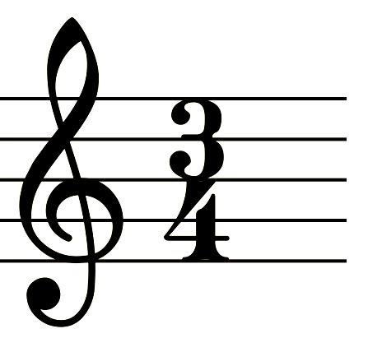
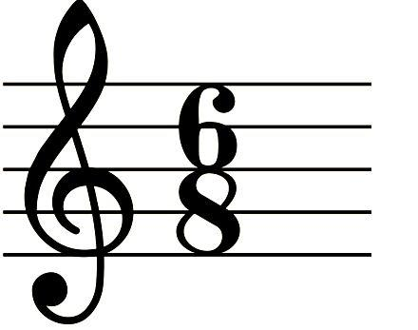
TIME SIGNATURES
Other time signatures include:

Slide 26
THE HASHTAG
Sharps, flats, and naturals change the pitch of a note to make it slightly higher (sharp), slightly lower (flat), or return it to normal (natural)
Notes:
Flat tire
Sharp Tack

Slide 27
Thanks for participating!
You’re now ready read your music!!
Notes:
Remind students that this is posted to the website

